Slide 1
Tasks, async/await and multithreading quiz
David Omid

Slide 2
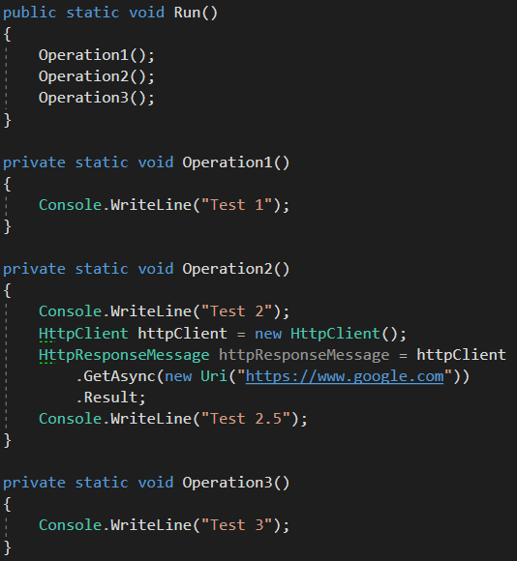
Question 1
What will be the output of the Run method?
Test 1 Test 2 Test 2.5 Test 3
Test 1 Test 2
Test 1 Test 2 Test 3
None of the above.

Slide 3
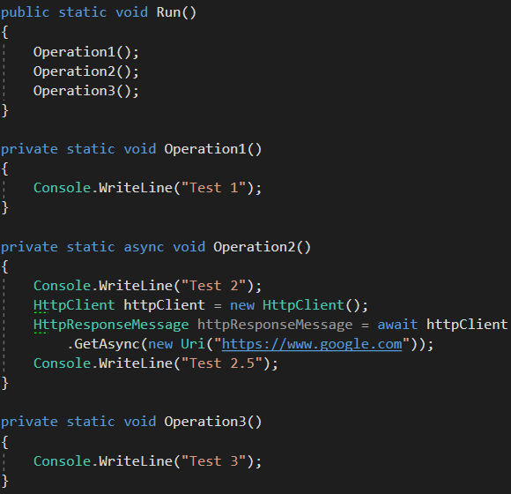
Question 2
What will be the output of the Run method?
Test 1 Test 2 Test 3
Test 1 Test 2
Test 1 Test 3
Test 1 Test 2 Test 2.5 Test 3
None of the above.

Slide 4
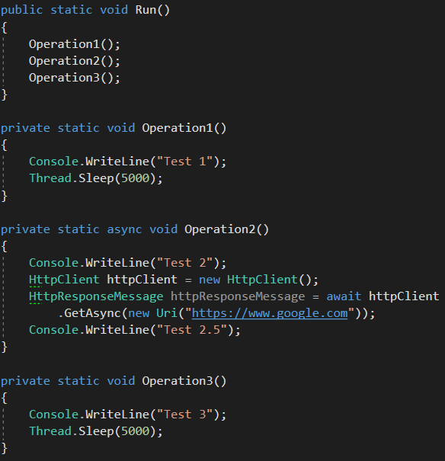
Question 3
What will be the output of the Run method?
Test 1 Test 2 Test 3
Test 1 Test 2
Test 1 Test 3
Test 1 Test 2 Test 2.5 Test 3
None of the above.

Slide 5
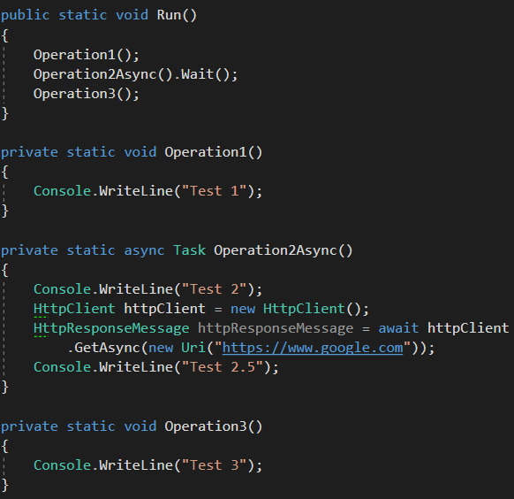
Question 4
What will be the output of the Run method?
Test 1 Test 2 Test 3
Test 1 Test 2
Test 1 Test 3
Test 1 Test 2 Test 2.5 Test 3
None of the above.

Slide 6
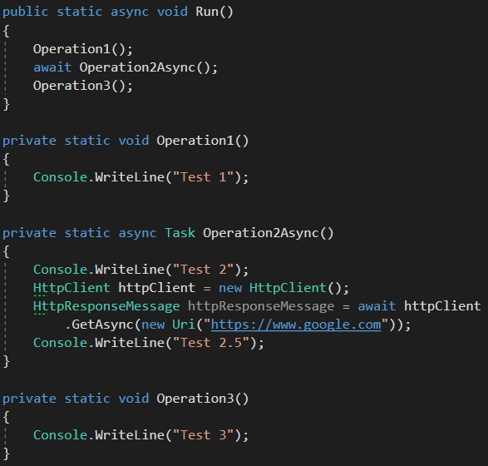
Question 5
What will be the output of the Run method?
Test 1 Test 2 Test 3
Test 1 Test 2
Test 1 Test 3
Test 1 Test 2 Test 2.5 Test 3
None of the above.

Slide 7
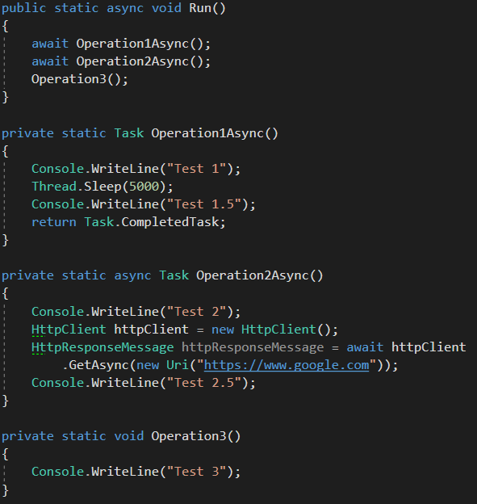
Question 6
What will be the output of the Run method?
Test 1 Test 1.5
Test 1 Test 1.5 Test 2
Test 1 Test 1.5 Test 2 Test 3
Test 1 Test 1.5 Test 2 Test 2.5 Test 3
None of the above.

Slide 8
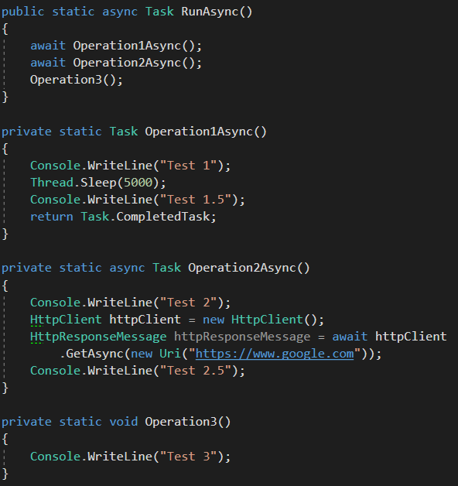
Question 7
What will be the output of the RunAsync method?
Test 1 Test 1.5
Test 1 Test 1.5 Test 2
Test 1 Test 1.5 Test 2 Test 3
Test 1 Test 1.5 Test 2 Test 2.5 Test 3
None of the above.

Slide 9
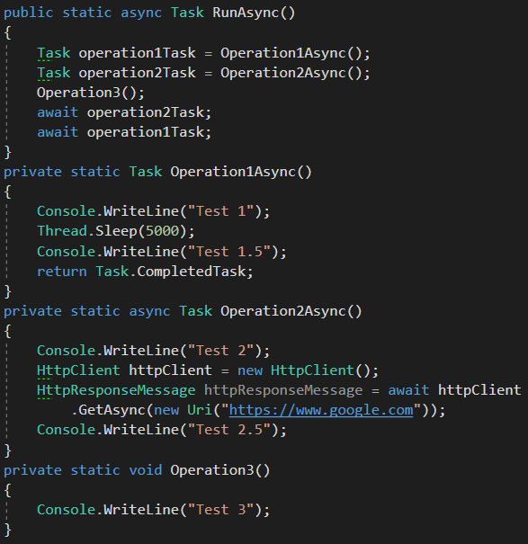
What will be the output of the RunAsync method?
Test 3 Test 2 Test 1 Test 1.5
Test 3 Test 1 Test 1.5 Test 2
Test 1 Test 1.5 Test 2 Test 3 Test 2.5
Test 1 Test 1.5 Test 2 Test 2.5 Test 3
Question 8
E. None of the above

Slide 10
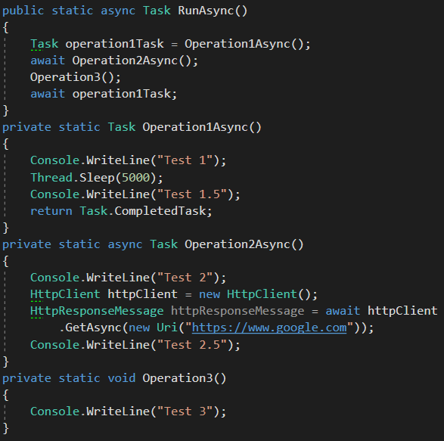
What will be the output of the RunAsync method?
Test 2 Test 3 Test 2.5 Test 1 Test 1.5
Test 2 Test 2.5 Test 3 Test 1 Test 1.5
Test 1 Test 1.5 Test 2 Test 3 Test 2.5
Question 9
D. Test 1 Test 1.5
Test 2 Test 2.5 Test 3
E. None of the above

Slide 11
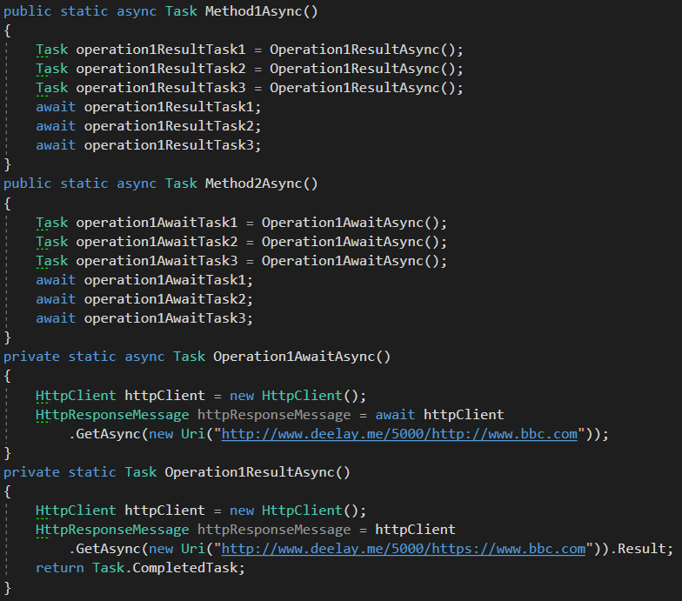
Question 10
Which of these methods has the fastest performance? Method1Async or Method2Async?
Method1Async
Method2Async
They both have similar performance.

Slide 12
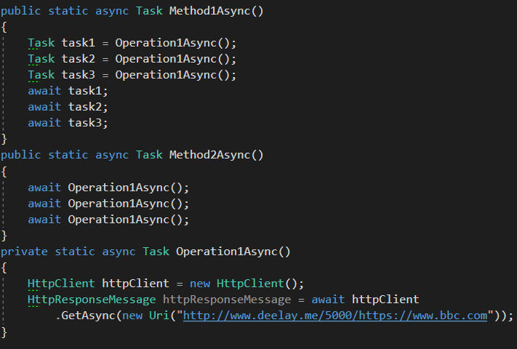
Question 11
Which of these methods has the fastest performance? Method1Async or Method2Async?
Method1Async
Method2Async
They both have similar performance.

Slide 13
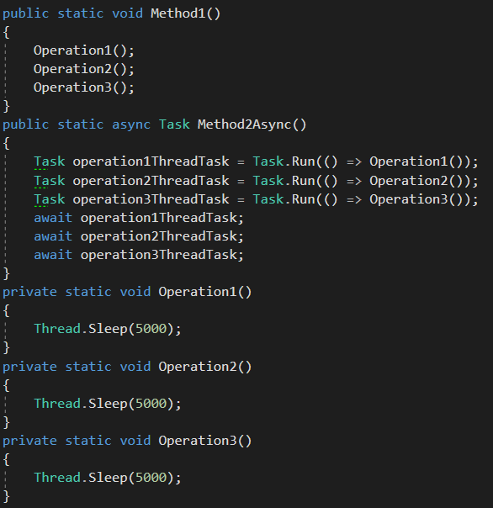
Question 12
Which of these methods has the fastest performance? Method1Async or Method2Async?
Method1
Method2Async
They both have similar performance.

Slide 14
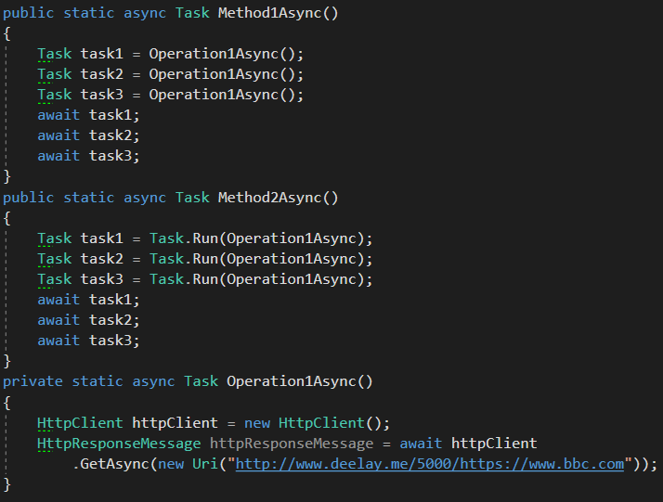
Question 13
Which of these methods has the fastest performance? Method1Async or Method2Async?
Method1Async
Method2Async
They both have similar performance.

Slide 15
Answers

Slide 16
Question 1
What will be the output of the Run method?
Test 1 Test 2 Test 2.5 Test 3

Slide 17
Question 2
What will be the output of the Run method?
Test 1 Test 2 Test 3

Slide 18
Question 3
What will be the output of the Run method?
E. None of the above
Test 1
Test 2
Test 3
Test 2.5

Slide 19
Question 4
What will be the output of the Run method?
D). Test 1
Test 2
Test 2.5
Test 3

Slide 20
Question 5
What will be the output of the Run method?
B. Test 1 Test 2

Slide 21
Question 6
What will be the output of the Run method?
B. Test 1 Test 1.5 Test 2

Slide 22
Question 7
What will be the output of the RunAsync method?
D. Test 1 Test 1.5 Test 2 Test 2.5 Test 3

Slide 23
What will be the output of the RunAsync method?
C. Test 1 Test 1.5 Test 2 Test 3 Test 2.5
Question 8

Slide 24
What will be the output of the RunAsync method?
Question 9
D. Test 1 Test 1.5
Test 2 Test 2.5 Test 3

Slide 25
Question 10
Which of these methods has the fastest performance? Method1Async or Method2Async?
B. Method2Async

Slide 26
Question 11
Which of these methods has the fastest performance? Method1Async or Method2Async?
Method1Async

Slide 27
Question 12
Which of these methods has the fastest performance? Method1Async or Method2Async?
B. Method2Async

Slide 28
Question 13
Which of these methods has the fastest performance? Method1Async or Method2Async?
C. They both have similar performance.

